Slide 1

Week 7 - Lecture
ACN – Routing Mechanisms
enda.stafford@ncirl.ie

Slide 2
Agenda
Routing
Routing Protocols

Slide 3

Routing

Slide 4
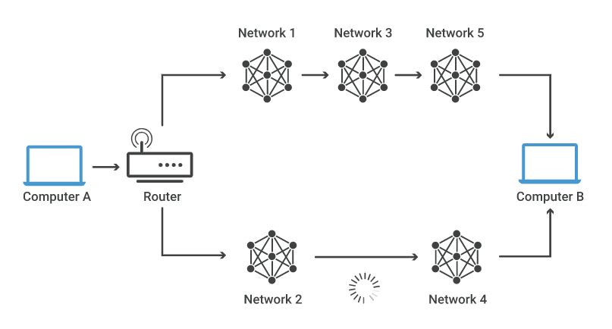
What is Network Routing
Network routing is the process of selecting a path across one or more networks.
Applies to any type of network
Routing selects the paths for Internet Protocol (IP) packets to travel from their origin to their destination
Notes:
Consider the image below. For a data packet to get from Computer A to Computer B, should it pass through networks 1, 3, and 5 or networks 2 and 4? The packet will take a shorter path through networks 2 and 4, but networks 1, 3, and 5 might be faster at forwarding packets than 2 and 4. These are the kinds of choices network routers constantly make.

Slide 5
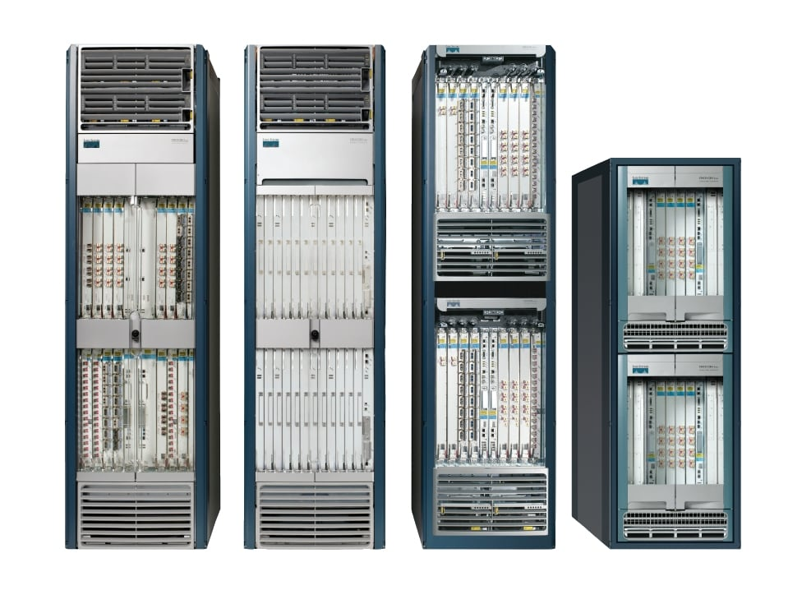
What is a router?
A piece of hardware responsible for forwarding packets to their destinations.
Usually connect two or more IP networks or subnetworks
Types of Routers:
Core router
Edge Router
Subscriber Edge router
Used in:
Homes
Offices
All across the internet
Core Route: Cisco CRS-X system
Notes:
https://www.cisco.com/c/en/us/support/routers/crs-1-multishelf-system/model.html
Edge router (also called a provider edge router): Placed at the edge of an ISP network. The router uses Exterior Border Gateway Protocol (EBGP) to routers at other ISPs or large enterprise autonomous systems.
Subscriber edge router (also called a customer edge router): Located at the edge of the subscriber's network, it also uses EBGP to its provider's autonomous system. It is typically used in an (enterprise) organization.
Inter-provider border router: A BGP router for interconnecting ISPs that maintains BGP sessions with other BGP routers in ISP Autonomous Systems.
Core router: Resides within an Autonomous System as a back bone to carry traffic between edge routers.^{[15]}

Slide 6
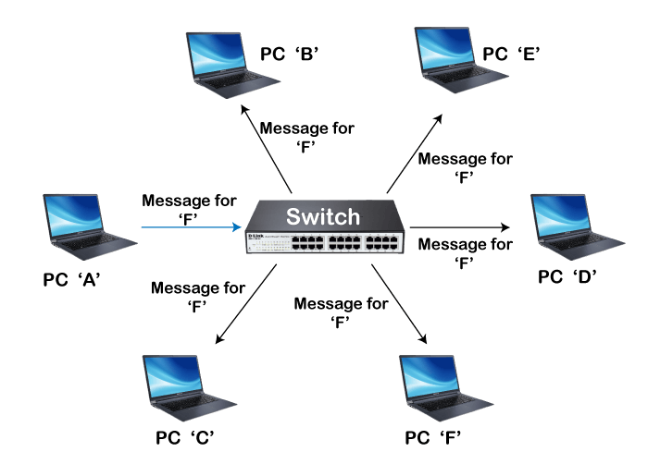
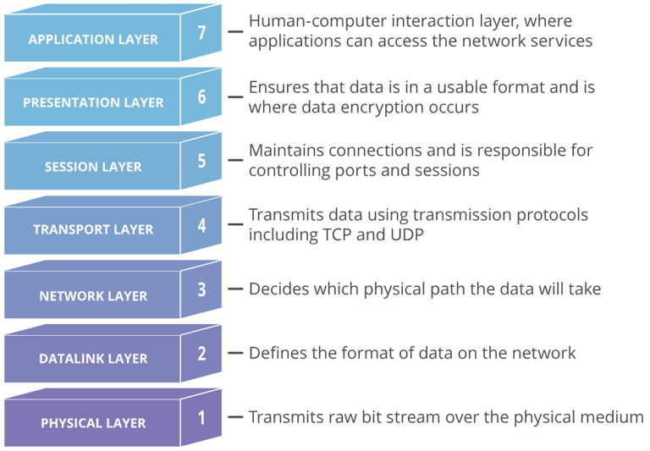
Router v switch
Switch:
Main function is to connect devices within a network
Works on Data link Layer of OSI
Aim is to determine destination and forward packets
Notes:
https://www.javatpoint.com/switch-vs-router

Slide 7
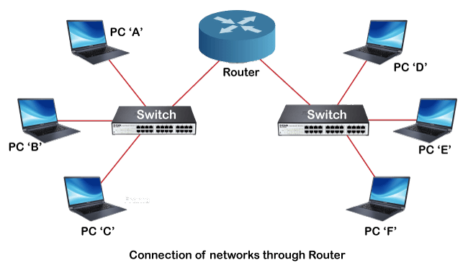
Router v switch
Router:
Main function is to connect different networks together
Connects multiple switches
Works on Network Layer of OSI
Aims to find the smallest and best routes for packets to reach their destination
Has more features compared to switches
Notes:
https://www.javatpoint.com/switch-vs-router

Slide 8
How does routing work?
A router will refer to its internal routing table to direct packets along network paths
Routers record every path that a packet should take to reach destinations that the router is responsible for.
Analogy: Train timetable
People consult a timetable to decide which train to take
Routing tables are like this but for network paths

Slide 9
What is a routing table?
A set of rules, often in table format, that is used to determine where data packets will be directed
All IP enabled devices use routing tables
Each entry in the routing table consists of the following entries:
Network ID (network destination):
The network ID or destination corresponding to the route.
Subnet Mask (Netmask):
The mask that is used to match a destination IP address to the network ID.
Next Hop (gateway):
The IP address to which the packet is forwarded
Outgoing Interface (interface):
Outgoing interface the packet should go out to reach the destination network.

Slide 10
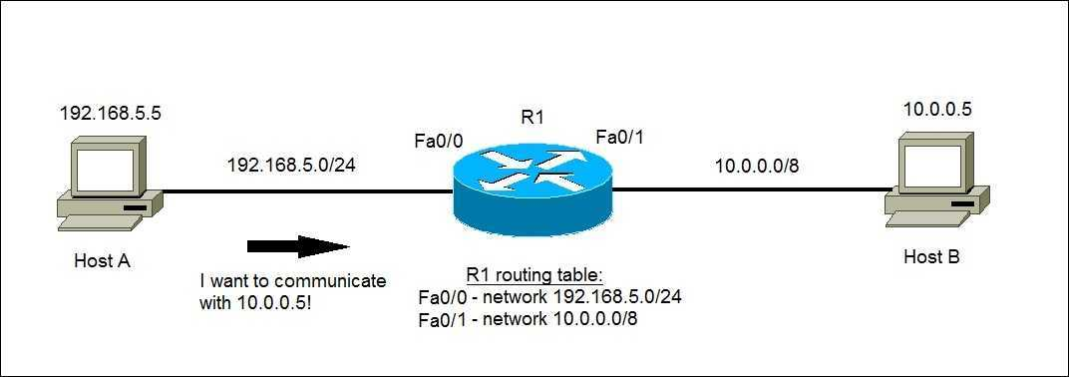
Routing example
Router receives a packet
Reads headers
Determines destination IP address
Using routing table, determine next hop
Send packet towards destination
This happens millions of times per second with millions of packets

Slide 11
Routing Types
Static Routes
Routing tables do not change
Network administrator manually sets routes
“set in stone” routes
Requires less computing power
Dynamic Routing
Routing tables update automatically
Used in various routing protocols (see next section)
Determines shortest and fastest paths
Requires more computing power

Slide 12
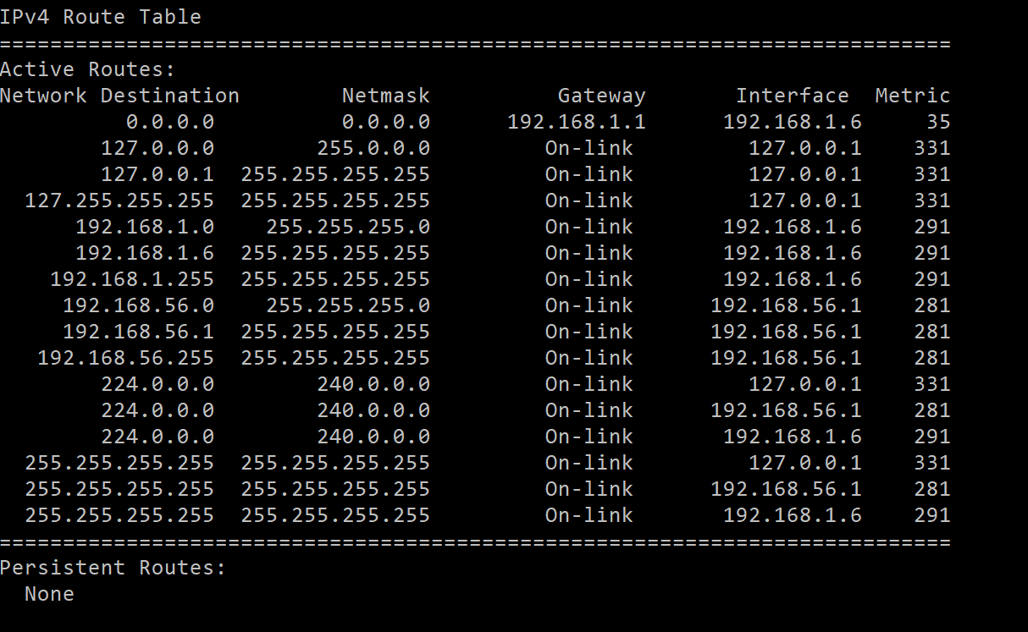
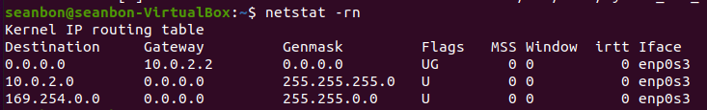
Exercise: Check your own routing table
Windows:
route print
Linux:
route
netstat -rn
Mac:
route
netstat -rn

Slide 13
Routing Protocols

Slide 14
Types of Routing protocol
Distance Vector | Link State
Sends entire routing table during updates | Only provides link state information
Sends periodic updates every 30-90 seconds | Uses triggered updates
Broadcasts updates | Multi casts updates
Vulnerable to routing loops | No risk of routing loops
RIP, IGRP | OSPF, IS-IS
There are two main types of routing protocol
Distance Vector Routing
Link state Routing
There is a third also
Path Vector Routing
Similar to distance vector, but uses analysis of the path itself instead of distance
Notes:
Link state:
Distance Vector:
Distance Vector Routing Algorithm
The Distance vector algorithm is iterative, asynchronous and distributed.
Distributed: It is distributed in that each node receives information from one or more of its directly attached neighbors, performs calculation and then distributes the result back to its neighbors.
Iterative: It is iterative in that its process continues until no more information is available to be exchanged between neighbors.
Asynchronous: It does not require that all of its nodes operate in the lock step with each other.
The Distance vector algorithm is a dynamic algorithm.
It is mainly used in ARPANET, and RIP.
Each router maintains a distance table known as Vector.
A distance-vector routing (DVR) protocol requires that a router inform its neighbors of topology changes periodically. Historically known as the old ARPANET routing algorithm (or known as Bellman-Ford algorithm).
https://www.geeksforgeeks.org/distance-vector-routing-dvr-protocol/
https://www.javatpoint.com/distance-vector-routing-algorithm
Path Vector:
A path vector protocol is essentially a distance vector protocol that does not rely on the distance to destination to guarantee a loop-free path but instead relies on the analysis of the path itself.
It is typically deployed in environments where it is difficult to guarantee a consistent metric (distance) across the routing domain. The path is accumulated at each router, and carried in each advertisement, so that any router receiving it can validate the loop-free path before propagating the information. BGP4 is the best example of an RP using this technology.
The main drawback is the size of the advertisements, which grow with the number of hops. As far as IPv6 is concerned, BGP4, enhanced with multiprotocol extensions, remains the path vector RP of choice for exchanging IPv6 routes between autonomous systems.

Slide 15
What are the main routing protocols?
IP
RIP
OSPF
Gateway Protocols
Interior Gateway Protocol (IGRP)
Enhanced IGRP
Exterior Gateway Protocol
Border Gateway Protocol

Slide 16
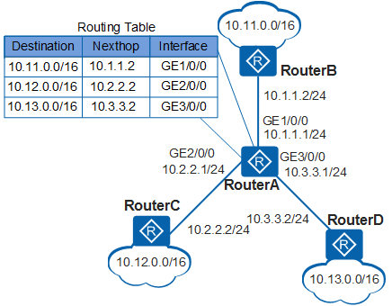
IP Routing
Umbrella term for all routing protocols
Packets follow path in order to travel across multiple networks
Routed through a series of routers across multiple networks
Routers use their routing tables to forward packets to the next hop
The next router then repeats this step until a packet reaches its destination

Slide 17
RIP(v1) – Routing Information Protocol
Oldest Distance Vector Protocol - Invented in 1988
Used in LAN and WAN’s
Runs at Application Layer in OSI model
Determines paths based on the hop count of the journey.
Broadcasts its routing table to all routers connected to the network
RIPv2 – adds extra functionality – multicast, authentication
Limitation
Max hop count of 15 – unsuitable for larger networks
Large traffic burst every 30 seconds

Slide 18
OSPF – Open Shortest Path First
Link state Protocol – Part of the Interior Gateway Protocol Family
OSPF routers share topology information so that every router has a complete picture of the topology
This is then used to calculate the end-to-end path
Routes within an autonomous system
Uses Link State Advertisements to build topology map.
From this map, each router calculates its routing table using a ‘shortest path’ algorithm e.g. Dijkstra algorithm
Provides for ‘Area’ routing – topology defined per ‘area’
Notes:
https://www.metaswitch.com/knowledge-center/reference/what-is-open-shortest-path-first-ospf
OSPF Areas:
Backbone area[edit]
The backbone area (also known as area 0 or area 0.0.0.0) forms the core of an OSPF network. All other areas are connected to it, either directly or through other routers. Inter-area routing happens via routers connected to the backbone area and to their own associated areas. It is the logical and physical structure for the 'OSPF domain' and is attached to all nonzero areas in the OSPF domain. Note that in OSPF the term Autonomous System Boundary Router (ASBR) is historic, in the sense that many OSPF domains can coexist in the same Internet-visible autonomous system, RFC 1996.^{[17][18]}
All OSPF areas must connect to the backbone area. This connection, however, can be through a virtual link. For example, assume area 0.0.0.1 has a physical connection to area 0.0.0.0. Further assume that area 0.0.0.2 has no direct connection to the backbone, but this area does have a connection to area 0.0.0.1. Area 0.0.0.2 can use a virtual link through the transit area 0.0.0.1 to reach the backbone. To be a transit area, an area has to have the transit attribute, so it cannot be stubby in any way.
Regular area[edit]
A regular area is just a non-backbone (nonzero) area without specific feature, generating and receiving summary and external LSAs. The backbone area is a special type of such area.
Transit area[edit]
In OSPF requires all areas to be directly connected to the backbone area, if not Virtual links have to be used, and the area that it transit called Transit area.
A transit area is an area with two or more OSPF border routers and is used to pass network traffic from one adjacent area to another. The transit area does not originate this traffic and is not the destination of such traffic. The backbone area is a special type of transit area.
Stub area[edit]
In hello packets the E flag is not high, indication "External routing: not capable"A stub area is an area that does not receive route advertisements external to the AS and routing from within the area is based entirely on a default route. An ABR deletes type 4, 5 LSAs from internal routers, sends them a default route of 0.0.0.0 and turns itself into a default gateway. This reduces LSDB and routing table size for internal routers.
Modifications to the basic concept of stub area have been implemented by systems vendors, such as the totally stubby area (TSA) and the not-so-stubby area (NSSA), both an extension in Cisco Systems routing equipment.
Totally stubby area[edit]
A totally stubby area is similar to a stub area. However, this area does not allow summary routes in addition to not having external routes, that is, inter-area (IA) routes are not summarized into totally stubby areas. The only way for traffic to get routed outside the area is a default route which is the only Type-3 LSA advertised into the area. When there is only one route out of the area, fewer routing decisions have to be made by the route processor, which lowers system resource utilization.
Occasionally, it is said that a TSA can have only one ABR.^{[19]}Not-so-stubby area[edit]
In hello packets the N flag is set high, indication "NSSA: supported"A not-so-stubby area (NSSA) is a type of stub area that can import autonomous system external routes and send them to other areas, but still cannot receive AS-external routes from other areas.^{[20]} NSSA is an extension of the stub area feature that allows the injection of external routes in a limited fashion into the stub area. A case study simulates an NSSA getting around the Stub Area problem of not being able to import external addresses. It visualizes the following activities: the ASBR imports external addresses with a type 7 LSA, the ABR converts a type 7 LSA to type 5 and floods it to other areas, the ABR acts as an "ASBR" for other areas. The ASBRs do not take type 5 LSAs and then convert to type 7 LSAs for the area.
Totally Not-so-stubby area[edit]
An addition to the standard functionality of an NSSA, the totally stubby NSSA is an NSSA that takes on the attributes of a TSA, meaning that type 3 and 4 summary routes are not flooded into this type of area. It is also possible to declare an area both totally stubby and not-so-stubby, which means that the area will receive only the default route from area 0.0.0.0, but can also contain an autonomous system boundary router (ASBR) that accepts external routing information and injects it into the local area, and from the local area into area 0.0.0.0.
Redistribution into an NSSA area creates a special type of LSA known as type 7, which can exist only in an NSSA area. An NSSA ASBR generates this LSA, and an NSSA ABR router translates it into type 5 LSA which gets propagated into the OSPF domain.A newly acquired subsidiary is one example of where it might be suitable for an area to be simultaneously not-so-stubby and totally stubby if the practical place to put an ASBR is on the edge of a totally stubby area. In such a case, the ASBR does send externals into the totally stubby area, and they are available to OSPF speakers within that area. In Cisco's implementation, the external routes can be summarized before injecting them into the totally stubby area. In general, the ASBR should not advertise default into the TSA-NSSA, although this can work with extremely careful design and operation, for the limited special cases in which such an advertisement makes sense.
By declaring the totally stubby area as NSSA, no external routes from the backbone, except the default route, enter the area being discussed. The externals do reach area 0.0.0.0 via the TSA-NSSA, but no routes other than the default route enter the TSA-NSSA. Routers in the TSA-NSSA send all traffic to the ABR, except to routes advertised by the ASBR.

Slide 19
OSPF – Open Shortest Path First … contd.
Advantages
Allows traffic engineering due to knowledge of E-2-E paths
Disadvantage
Does not scale well. More routers mean more topology updates
Notes:
https://www.metaswitch.com/knowledge-center/reference/what-is-open-shortest-path-first-ospf
OSPF Areas:
Backbone area[edit]
The backbone area (also known as area 0 or area 0.0.0.0) forms the core of an OSPF network. All other areas are connected to it, either directly or through other routers. Inter-area routing happens via routers connected to the backbone area and to their own associated areas. It is the logical and physical structure for the 'OSPF domain' and is attached to all nonzero areas in the OSPF domain. Note that in OSPF the term Autonomous System Boundary Router (ASBR) is historic, in the sense that many OSPF domains can coexist in the same Internet-visible autonomous system, RFC 1996.^{[17][18]}
All OSPF areas must connect to the backbone area. This connection, however, can be through a virtual link. For example, assume area 0.0.0.1 has a physical connection to area 0.0.0.0. Further assume that area 0.0.0.2 has no direct connection to the backbone, but this area does have a connection to area 0.0.0.1. Area 0.0.0.2 can use a virtual link through the transit area 0.0.0.1 to reach the backbone. To be a transit area, an area has to have the transit attribute, so it cannot be stubby in any way.
Regular area[edit]
A regular area is just a non-backbone (nonzero) area without specific feature, generating and receiving summary and external LSAs. The backbone area is a special type of such area.
Transit area[edit]
In OSPF requires all areas to be directly connected to the backbone area, if not Virtual links have to be used, and the area that it transit called Transit area.
A transit area is an area with two or more OSPF border routers and is used to pass network traffic from one adjacent area to another. The transit area does not originate this traffic and is not the destination of such traffic. The backbone area is a special type of transit area.
Stub area[edit]
In hello packets the E flag is not high, indication "External routing: not capable"A stub area is an area that does not receive route advertisements external to the AS and routing from within the area is based entirely on a default route. An ABR deletes type 4, 5 LSAs from internal routers, sends them a default route of 0.0.0.0 and turns itself into a default gateway. This reduces LSDB and routing table size for internal routers.
Modifications to the basic concept of stub area have been implemented by systems vendors, such as the totally stubby area (TSA) and the not-so-stubby area (NSSA), both an extension in Cisco Systems routing equipment.
Totally stubby area[edit]
A totally stubby area is similar to a stub area. However, this area does not allow summary routes in addition to not having external routes, that is, inter-area (IA) routes are not summarized into totally stubby areas. The only way for traffic to get routed outside the area is a default route which is the only Type-3 LSA advertised into the area. When there is only one route out of the area, fewer routing decisions have to be made by the route processor, which lowers system resource utilization.
Occasionally, it is said that a TSA can have only one ABR.^{[19]}Not-so-stubby area[edit]
In hello packets the N flag is set high, indication "NSSA: supported"A not-so-stubby area (NSSA) is a type of stub area that can import autonomous system external routes and send them to other areas, but still cannot receive AS-external routes from other areas.^{[20]} NSSA is an extension of the stub area feature that allows the injection of external routes in a limited fashion into the stub area. A case study simulates an NSSA getting around the Stub Area problem of not being able to import external addresses. It visualizes the following activities: the ASBR imports external addresses with a type 7 LSA, the ABR converts a type 7 LSA to type 5 and floods it to other areas, the ABR acts as an "ASBR" for other areas. The ASBRs do not take type 5 LSAs and then convert to type 7 LSAs for the area.
Totally Not-so-stubby area[edit]
An addition to the standard functionality of an NSSA, the totally stubby NSSA is an NSSA that takes on the attributes of a TSA, meaning that type 3 and 4 summary routes are not flooded into this type of area. It is also possible to declare an area both totally stubby and not-so-stubby, which means that the area will receive only the default route from area 0.0.0.0, but can also contain an autonomous system boundary router (ASBR) that accepts external routing information and injects it into the local area, and from the local area into area 0.0.0.0.
Redistribution into an NSSA area creates a special type of LSA known as type 7, which can exist only in an NSSA area. An NSSA ASBR generates this LSA, and an NSSA ABR router translates it into type 5 LSA which gets propagated into the OSPF domain.A newly acquired subsidiary is one example of where it might be suitable for an area to be simultaneously not-so-stubby and totally stubby if the practical place to put an ASBR is on the edge of a totally stubby area. In such a case, the ASBR does send externals into the totally stubby area, and they are available to OSPF speakers within that area. In Cisco's implementation, the external routes can be summarized before injecting them into the totally stubby area. In general, the ASBR should not advertise default into the TSA-NSSA, although this can work with extremely careful design and operation, for the limited special cases in which such an advertisement makes sense.
By declaring the totally stubby area as NSSA, no external routes from the backbone, except the default route, enter the area being discussed. The externals do reach area 0.0.0.0 via the TSA-NSSA, but no routes other than the default route enter the TSA-NSSA. Routers in the TSA-NSSA send all traffic to the ABR, except to routes advertised by the ASBR.

Slide 20
Gateway Protocols
Interior Gateway Protocol (IGRP)
Created by Cisco
Uses many of RIP’s functions
Increases maximum hop count to 100 – more useful for larger networks
Automatically updates changes – e.g. route adjustments.
Enhanced IGRP
Created by Cisco
Allows for 255 hops
Maximizes efficiency by using different update algorithm and speeds up data convergence
If a change occurs, each router notifies its neighbours.

Slide 21
Gateway Protocols
Exterior Gateway Protocol (EGP)
Useful for exchanging information between gateway hosts within Autonomous Systems
Provides a space for routers to share information across domains or AS’s
An EGP routing table stores:
Recognized routers
Route costs
Network addresses of nearby devices
Notes:
AS - Autonomous Systems

Slide 22
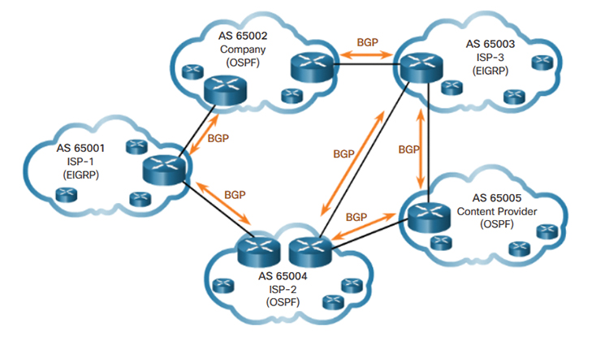
Border Gateway Protocol
Is the protocol underlying the global routing system of the internet
BGP directs packets between AS’s, which in turn may use other protocols internally.
Guarantees routers can adapt to failure
When one path is down, another is found
Routing Table generated by BGP process on the router.
BGP is more scalable
Notes:
What is BGP used for?
BGP offers network stability that guarantees routers can quickly adapt to send packets through another reconnection if one internet path goes down. BGP makes routing decisions based on paths, rules or network policies configured by a network administrator. Each BGP router maintains a standard routing table used to direct packets in transit. BGP uses client-server topology to communicate routing information, with the client-server initiating a BGP session by sending a request to the server.
BGP routing basics
BGP sends updated router table information only when something changes, and only the affected information. BGP has no automatic discovery mechanism, which means connections between peers must be set up manually, with peer addresses programmed in at both ends.
BGP makes best-path decisions based on current reachability, hop counts and other path characteristics. In situations where multiple paths are available -- as within a major hosting facility -- BGP policies communicate an organization's preferences for what path traffic should follow in and out. BGP community tags can control route advertisement behavior among peers.
BGP in networking is based on TCP/IP. It operates on the OSI Transport Layer (Layer 4) to control the Network Layer (Layer 3). As described in RFC4271 and ratified in 2006, the current version of BGP-4 supports both IPv6 and Classless Inter-Domain Routing (CIDR), which enables the continued viability of IPv4. Use of the CIDR is a way to have more addresses within the network than with the current IP address assignment scheme.
Common BGP issues
Common issues with BGP include information exchange failures. Information exchanges don't always succeed as information can be improperly formatted or contain incorrect data. Routers can run out of memory or storage, or be too slow to respond to updates. Routers send error codes and subcodes to communicate problems including timeouts, malformed requests and processing problems.
BGP security
BGP is also vulnerable to attacks based on misinformation. Malicious actors can flood a router with bad packets in a denial-of-service attack, for example. They can also claim to be the source of routing information for an AS, and (temporarily) control where traffic headed from that AS goes, a practice known as BGP hijacking.
Difference between internal and external BGP, OSPF
When BGP is used to route within a single AS, it is called internal BGP, or iBGP. When used to connect one AS to others, it is called external BGP, or eBGP.
The OSPF (Open Shortest Path First) protocol is used only in internal networks. OSPF is focused on finding the shortest route available between nodes, and on failing over to that shortest route as quickly as possible. BGP is slower to fail to a new route but is more scalable. OSPF is essentially hierarchical in structure, while BGP is a mesh. Some networks are replacing OSPF with iBGP.
Facebook outage
Social media applications Facebook, Instagram and WhatsApp went offline for six hours on Oct. 4, 2021. The outage was reportedly due to there being no working BGP routes into the social media sites and the DNS servers going offline. This essentially disconnected the social media apps from the internet.

Slide 23
Why use routing protocols?
Routing protocols are required for the following reasons:
Allows optimal path selection
Offers loop-free routing
Fast convergence
Minimize update traffic
Easy to configure
Adapts to changes
Scales to a large size
Compatible with existing hosts and routers
Supports variable length

Slide 24

Questions?

